Slide 1
FRAUD
BY Student’s Name

Slide 2
FRAUD
Fraud refers to any actions that include deviant acts aimed at false representation of certain facts through words, actions or deliberate hiding of relevant information, which then results in the deception of another person who will use the false information to his legal disadvantage (West’s Encyclopedia of American Law, 2008).

Slide 3
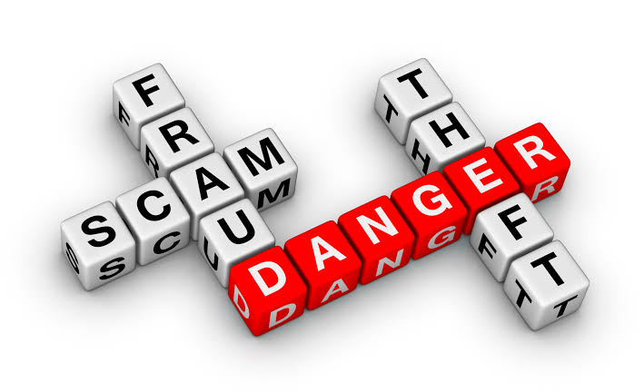
Fraud Cont.
Fraud is a type A offense since it is more
serious and often requires law enforcement
attention (US DOJ, 2012).
It is classified as a property crime because
it typically does not involve physical damage to a person NIBRS (US DOJ, 2012).

Slide 4
Fraud Cont.
The crime of fraud is covered by both civil and criminal laws.
The earliest historical accounts of fraud can be traced back to ancient Greece in the 6th Century BCE and ancient Egypt outlawing the use of false currencies, as well as inaccurate weights and counterfeit pieces of art which were sold to unknowing buyers (Trulioo, 2020).
In 18th and 19th Centuries, the instances of fraud recorded included the sale of the Brooklyn Bridge to tourists and the inflation of share prices (Trulioo, 2020).
Notes:
Criminal charges can only be brought forth by government prosecutors: however, a victim of fraud has a right to file a civil lawsuit. Occasionally, a fraudster is both sued in a civil action and criminally prosecuted. According to criminal law, government prosecutors must prove the fraud beyond a reasonable doubt. Defendants who are convicted of fraud are either sentenced to probation and fines or imprisoned for a period of six months to fives years. The standard of proof is usually lower in private civil lawsuit and the punishment issued is often restitution and monetary damages.

Slide 5

Fraud Cont.
Frauds in the 1900s included Frank Abagnale’s exploits, identity theft by the Roselli brothers, and phone-line scams in the 1800s (Trulioo, 2020).
In the 2000s, Ponzi schemes, false accounting, bribery, and cyber fraud surged due to technological advances.

Slide 6
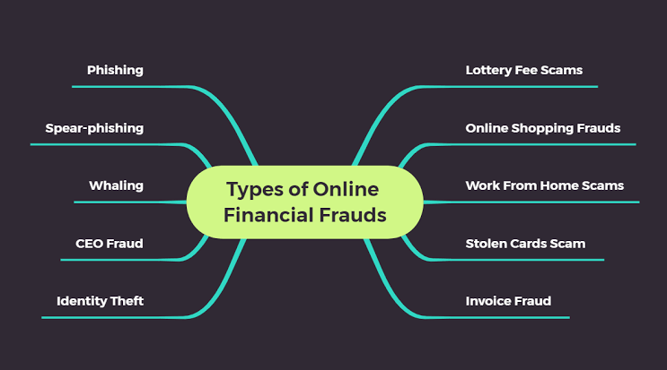
Fraud Cont.
Present-day fraudulent
Activities include
impersonation,
welfare fraud,
wire fraud, ATM &
credit card fraud, false pretenses, among others (US-DOJ, 2012).

Slide 7
VICTIMS OF FRAUD
Most victims of fraud are not those that many people would expect.
Men are more vulnerable to fraudsters than women (Carlson, 2018).
Men are likely to be victims of fraudulent activities because they tend to be overconfident.
Fraudsters target men because they tend to handle the finances of many U.S households, especially in older generations.
Notes:
Anyone can be a victim of fraud, but some people are at a greater risk of being frauded than others. People who are most vulnerable are not those that many people would assume. According to many people, the stereotypical financial fraud victim is the elderly person with limited cognitive functions who lives alone. The truth is that such type of a person is likely to be a victim of financial abuse which is different from fraud.

Slide 8
VICTIMS OF FRAUD CONT.
The stereotype that elderly people are more vulnerable to fraud is also wrong.
Research indicates that many victims of fraud are those in their 50s and 60s, and not those in their 70s (Carlson, 2018).
In addition, the common belief that illiterate people are more vulnerable than educated people to be victims of fraud is wrong.
Those with graduate degrees are the ones who have the highest chance of being scammed (Carlson, 2018).
Notes:
Research suggests that people who did not complete high school are actually less likely to be frauded than everybody else (Carlson, 2018). Those with graduate degrees are the ones who have the highest chance of being scammed (Carlson, 2018). The reason is not because those with graduate degrees are likely to be rich. Research indicates that being rich, on its own, is not a predictor of being a victim of fraud (Carlson, 2018). According to financial planners, more educated people fool themselves that because they are successful in their field of study, they can be excellent investors too (Carlson, 2018). As a result, they get overconfident which land them to big vulnerabilities in broken promises, poor investments and fraud.

Slide 9
Criminology Theory
The theory of criminology that best fits the crime of fraud is the sociological theory.
According to the sociological theory, people engage in crime because they do not see the benefits of adhering to social values and believe that engaging in criminal activities is the only way to improve their financial and social conditions (Akers & Jennings, 2019).

Slide 10
Criminology Theory
The sociological theory of criminology was developed by Robert Metron, who argued that the inability of an offender to meet their goals in the socially acceptable means puts them at the risk of using other non-social and illegal ways to pursue their objectives.
The tenant for the sociological theory is that the social environment is a contributor to criminal behaviors in individuals.
As people interact in the environment, they learn certain aspects of their behaviors from one another.

Slide 11

Prevalence of Fraud
Fraud is more profound than most other forms of crimes.
Incidences of fraud have been on the rise due to the
heightened use of modern technology (FBI, 2021).
A total of 2.2 million fraud cases that were done
through the internet were reported in the year 2020 (FBI, 2021).
Out of the 2.2 million cases, 34 per cent represented a loss of money through fraudulent techniques.

Slide 12
Prevalence of Fraud Cont.
Fraud crime is a major issue of concern for security authorities in the United States.
Security authorities in the United States receive fraudulent complaints from citizens daily (Junger, Wang, & Schlomer 2020).
It is difficult for the fraudsters to be arrested since most fraudulent activities are done through the internet.

Slide 13
Common Location of Fraud
Fraud activities are more profound in urban centers than in rural areas in the United States.
Fraud cases in urban centers are double those reported in rural areas (Internet Crime Report, 2020).
Out of the 2.2 million fraud cases that were reported in 2020, 74% were done in urban centers while the rest were done in rural areas (Internet Crime Report, 2020).

Slide 14
Current Deterrence Methods
There are two strategies that can be used to combat fraud.
The first strategy is enlightening the general public on how to detect fraudsters and avoid falling into the traps of fraudsters.
The second strategy that can assist in deterring fraud is through constant monitoring of own accounts and reporting any suspicious activities immediately.

Slide 15
References
Akers, R. L., & Jennings, W. G. (2019). The social learning theory of crime and deviance. In Handbook on crime and deviance (pp. 113-129). Springer, Cham.
Carlson, B. (2018). Who’s a likely scam victim? Not the people you expect. Forbes. Retrieved from https://www.forbes.com/sites/bobcarlson/2018/06/26/whos-a- likely-scam-victim-not-the-people-you-expect/?sh=215c8e3b2aae

Slide 16
References Cont.
FBI National Press Office. (2021). FBI Releases the Internet Crime Complaint Center 2020 Internet Crime Report, Including COVID-19 Scam Statistics. https://www.fbi.gov/news/pressrel/press-releases/fbi-releases-the-internet- crime-complaint- center-2020-internet-crime-report-including-covid-19- scam-statistics
Internet Crime Report. (2020). https://www.ic3.gov/Media/PDF/AnnualReport/2020_IC3Report.pdf

Slide 17
References Cont.
Junger, M., Wang, V., & Schlomer, M. (2020). Fraud Against Businesses Both Online and Offline: Crime Scripts, Business Characteristics, Efforts, And Benefits. 13: 1-15. https://crimesciencejournal.biomedcentral.com/track/pdf/10.1186/s40163- 020-00119- 4.pdf
Trulioo. (2020). A history of fraud: from ancient Egypt to the modern pandemic (Part 1). Retrieved from https://trulioo.medium.com/a-history-of-fraud-from-ancient-egypt-to-the-modern-pandemic-part-1-cbace1ba38af

Slide 18
References Cont.
U.S. Department of Justice—Federal Bureau of Investigation (2012). A Guide to Understanding NIBRS. Uniform Crime Reporting (UCR) Program. Retrieved from https://ucr.fbi.gov/nibrs/2012/resources/a-guide-to-understanding-nibrs
West’s Encyclopedia of American Law. (2008). Fraud. The Gale Group, Inc. https://legal-dictionary.thefreedictionary.com/fraud

